Slide 1
How data is organised on Computer Systems

Slide 2
Data Types/Structure
In order to run efficiently, computers need to be able to handle all forms of data. When a variable is defined, a data type usually also needs to be declared. This gives the computer an understanding of how much memory needs to be allocated, as well as what operations can be applied to an item of data. For example, you cannot store an integer in a variable designated for storing text and vice versa. A good understanding of different data types is essential in programming.
Type | Definition | Example
Integer | Whole number | 1
Real | Any positive or negative number | 1, -1
Boolean | A logical value | True, False
Character | A letter | “A”
String | text | Go eat a waffle
Date/Time | Shows the date In the format of dd/mm/yyyy | 11/03/2017
Pointer | A programming language object that references a location in memory | Int add_array (num12)

Slide 3
Use of Data (Processing)
There are many different ways in which computer systems can structure data into different sequences for processing. They involve 4 different methods and all have certain features, applications and implications on a computer system.
Stack
Queue
Array
List
On the next few slides:
Describe it?
Explain how does it works?
Provide a step by step example

Slide 4
Slide 3 questions
Stack - Stores requests that need to be handled.
a stack of money.
The first ton go into the stack is the last to come out. The top one is always taken off first.
Queue – A list of jobs waiting to be processed.
a waiting line at MacDonald’s.
The jobs are done in a linear sequential pattern once at a time.
Array – An indexed sequence of items of the same type.
A ranking list in sports.
A table that contains data in a sequence.
List – A flexible collection of items.
A shopping list.
A list can be a set of different variables / information.

Slide 5
Use of Data Types
All computer software is created using some form of programming environment and language, such as C#. Almost all software uses variables to hold information or data when the code runs. Defining a variable is required because it has at least 3 benefits:
More accurate Processing
Better use of Memory
Faster Processing
Expand on each point by explaining the 3 benefits further.

Slide 6
Indices and Matrices
A matrix is a rectangular collection of numbers which can be used in mathematical operations. Matrices are used in many areas of computing including calculations needed for ‘Wire-framing’, which forms the bases of virtual landscapes for gaming.
2D Matrices hold (x,y) coordinates of a shape on a grid
Can be manipulated with other Matrices to get new coordinates
The new coordinates can be used to Rotate, Mirror, Resize etc a shape
Indices are used to identify items in a matrix.

Slide 7
1d/2d/3d Arrays?
Antigone | Bethany | Clara | David | Eric | Fiona | Gerald | Hannah | Ian | Jorge
81 | 75 | 90 | 64 | 68 | 72 | 69 | 80 | 91 | 73
84 | 68 | 85 | 74 | 73 | 66 | 66 | 87 | 88 | 92
Test 1
Test 2
Arrays can have multiple dimensions; the most commonly used are two-dimensional arrays. Two-dimensional arrays are useful for grouping information together. For example, if the array of test scores from test 1 listed the scores of 10 different students in the same test, another row could be added for those students’ scores in another test (Test 2). In this case, each column would list all of the test scores for a particular student, while each row would give all of the scores for a particular test.
As two-dimensional arrays have both rows and columns, each element in the array has a row index and a column index. For example, Antigone’s score for the second test (84) could be accessed as scores[0][1], as this is the element in the column [0] and the row [1].
While arrays can be given more than two dimensions, the more dimensions there are, the more data they need and the harder it is to understand how all of the data links together.

Slide 8
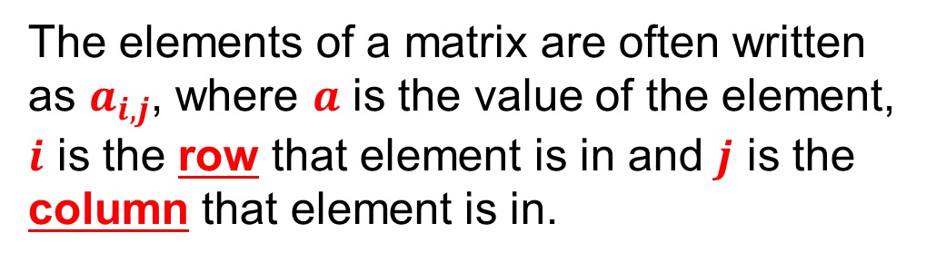

Matrices
A matrix is simply a two-dimensional array. Matrices are not only used for storing data in computers, but also for a wide variety of mathematical operations. Consider this matrix:
$\left[\begin{matrix}1_{1,1} & 2_{1,2} & 3_{1,3} \\ 4_{2,1} & 5_{2,2} & 6_{2,3} \\ 7_{3,1} & 8_{3,2} & 9_{3,3}\end{matrix}\right]$
The elements of a matrix are often written as $a_{i,j}$, where $a$ is the value of the element, $i$ is the row that element is in and $j$ is the column that element is in.
As memory locations are often linear (i.e. RAM will have memory locations 1, 2, 3, ...), there needs to be a way of determining how a matrix is stored in memory. This is done via Row-Major and Column-Major methods.

Slide 9
Row-Major / Column-Major
Put the following in the correct order or sequence.
13 31 1 63 60
76 47 4 49 8
74 63 91
76 46 51
21 65 46 61
Row Major (Your Answer)
Column Major (Your Answer)

Slide 10
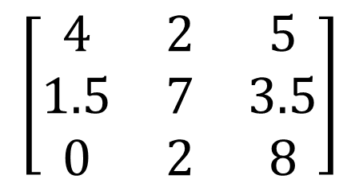
Indices and Matrices (Calculation)
$$\left[\begin{matrix}4 & 2 & 5 \\ 1.5 & 7 & 3.5 \\ 0 & 2 & 8\end{matrix}\right]$$
What would the result be of Value (1)*Value(6) in Row-Major order and if done via Column-Major order
Row-Major order Answer ___ ___
Column-Major order Answer ___ ___

